Slide 1

Range Trading
Trading team 1 - Conor Bennett, Zachary Ching, Luke Osborne

Slide 2
Outline
Range Trading and Technical Indicators
Trading Strategy
Algorithm
Algorithm Performance
Results and Findings
Conclusion

Slide 3
Range Trading and Technical Indicators
Average True Range
Used to view market volatility
Calculated from historical price data
Bollinger Bands
Determine trendlines based on standard deviations from simple moving average price.
Used when security no longer ranges horizontally and capitalises on market fluctuations.
Donchian Channels
Determines bullish and bearish trends
Determined through highest high and lowest lows within a certain period.
WHAT IS RANGE TRADING
“Range trading is a form of high-frequency trading which relies on exploiting temporary fluctuations in the price of an asset while the market ``ranges"; i.e. is not trending but moving sideways.”

Slide 4
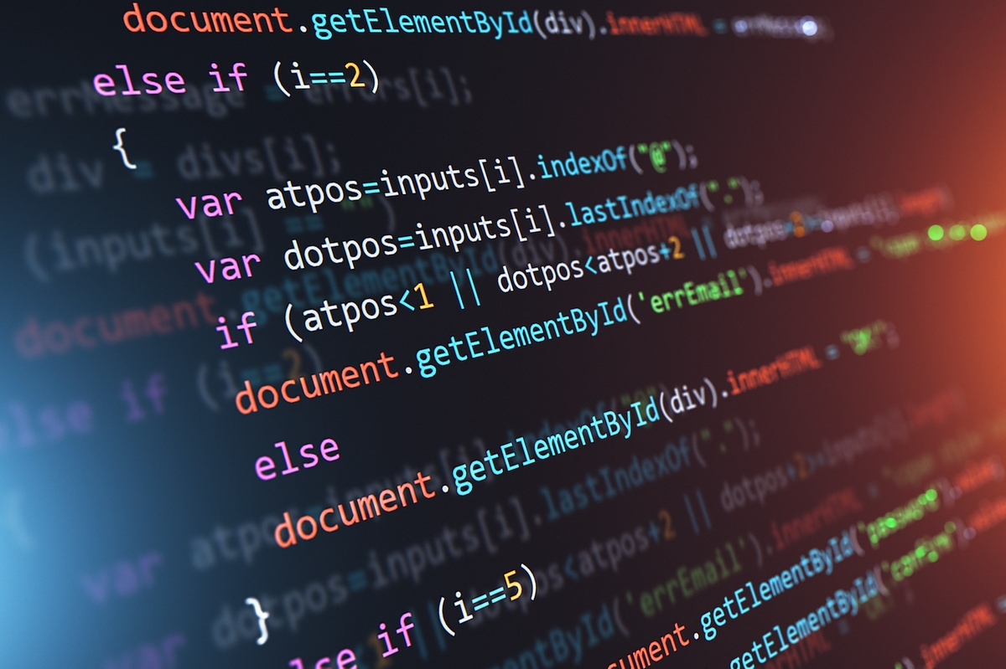
AlgorithmS
As a team, we utilised a range of different indicators to achieve our final trading algorithm.
We implemented two different strategies in our report, focusing on Range Trading and Bollinger Bands while maximising efficiency with the additional indicators.

Slide 5
Algorithm: Bollinger Bands
Rather than simply using the inbuilt Bollinger band parameters outlined in the mean_reversion_example code, we chose to expand this definition for a more comprehensive set of indicators.
We chose to run with three lengths of Bollinger bands, classified as “short”, “medium” and “long” with parameters as defined in the diagram adjacent.
These different bands can be used to identify more characteristics of the current trends.
This theory can be improved by modifying the buy-amount algorithm to adjust different scales of buy-values for each.
 | SHORT | MEDIUM | LONG
Timeframe (data points) | 10 | 20 | 50
# of standard deviations | 1.5 | 2.0 | 2.5

Slide 6
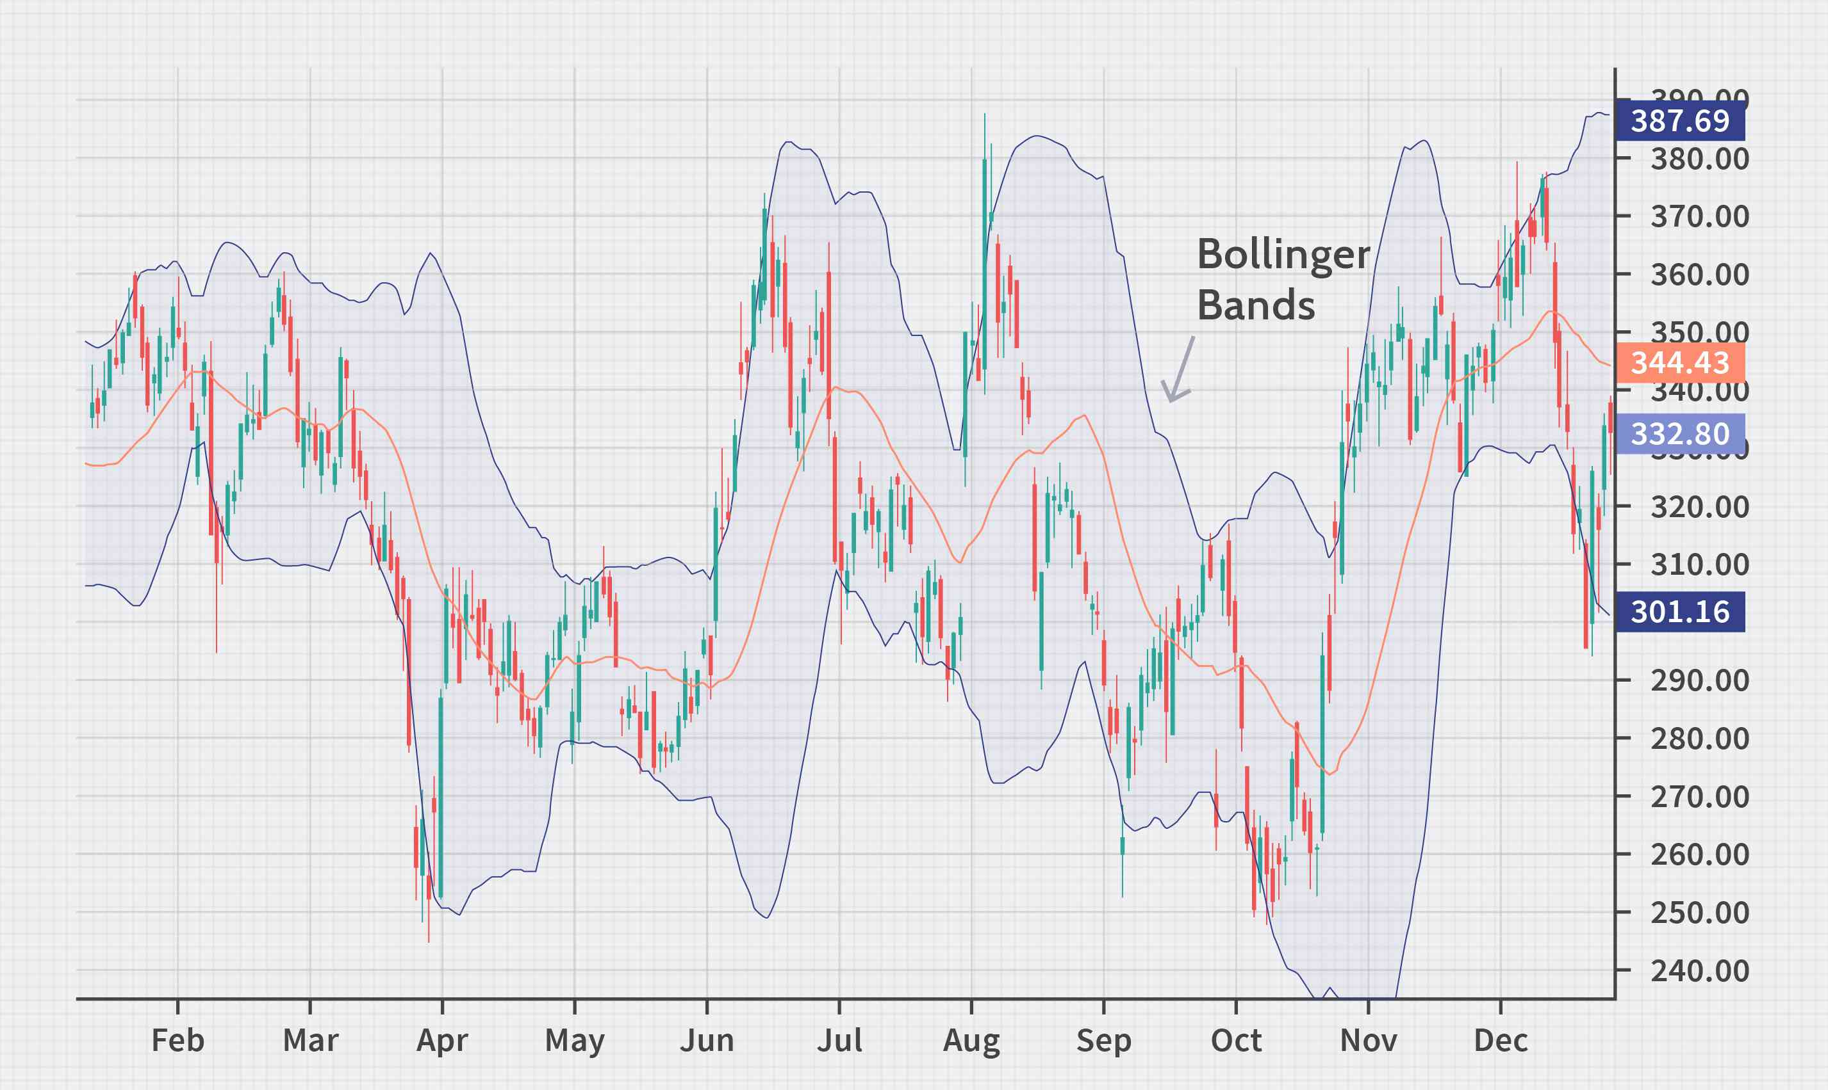
Algorithm: Bollinger Bands

Slide 7
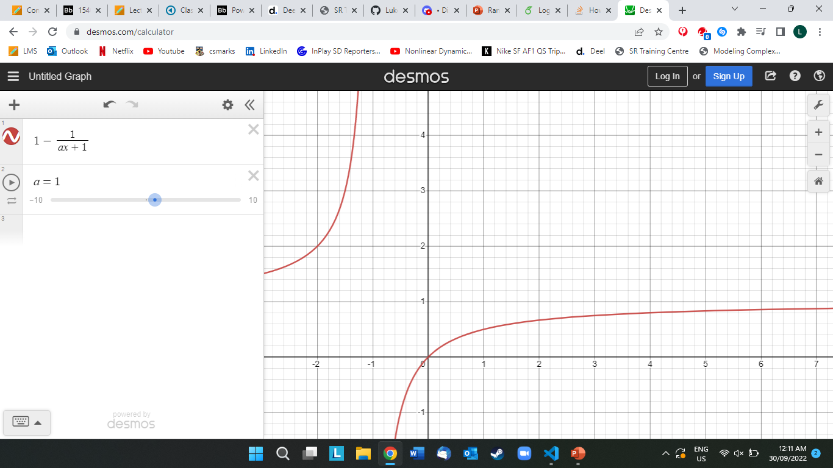
ADJUSTING BUY/SELL VARIABLES
By modifying the base code associated with the Bollinger bands, we can also adjust how much we invest into a position based on the distance it lies from our defined boundary.
Using a mathematical expression:
y = 1-1/(ax+1),
Modelled across for a = 1, we create a function that tends to y = 1 as x increases. If we define our x value to be the difference between the market price and the boundary, we can effectively use our function as intended.
This is fully prepared to test the algorithm on sample data to obtain an optimal value of a, but also allows for varying values across bands.

Slide 8
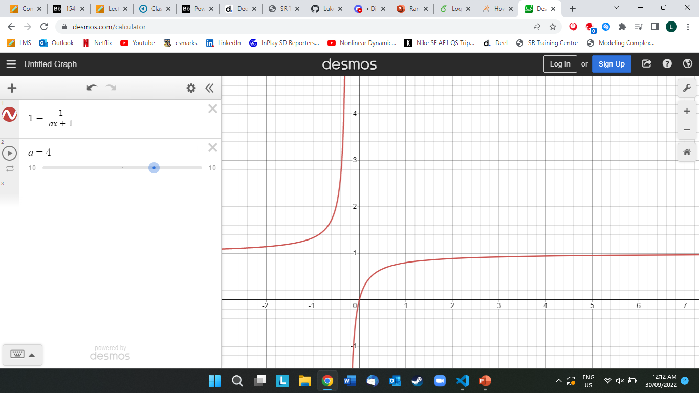
ADJUSTING BUY/SELL VARIABLES
Y = 1 – 1/(x+1)
Y = 1 – 1/(4x+1)

Slide 9
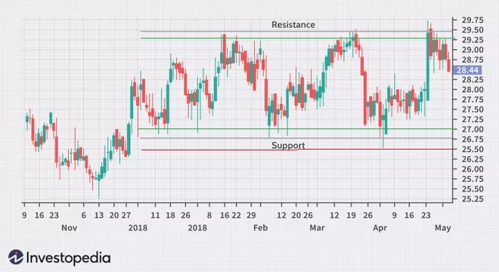
Algorithm: Range Trading
Average Directional Index was used to determine when the stocks/markets were not trending and rather, were trading horizontally.
In periods of horizontal trading, Ranges were established through finding maximums and minimums of horizontal trading periods and adding a standard deviation buffer.
Entry Positions and Stop Losses were identified through determining upper and lower bounds and adding/subtracting a standard deviation.

Slide 10
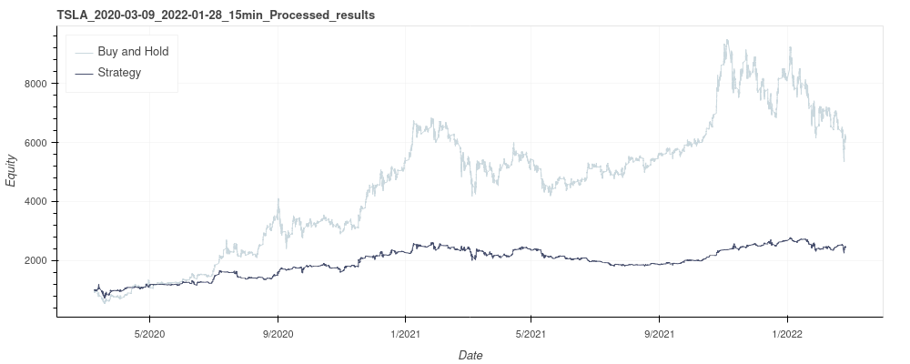
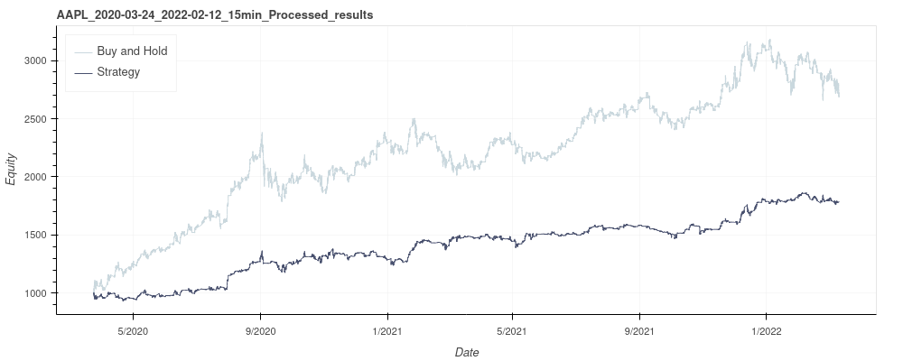
Results and Findings
Final Results
Key Strength laid in synergising strengths of difference algorithms.
Bollinger Bands performed better in fluctuating periods and Range Trading performed better horizontal periods.
Throughout our development, back-testing was used on high-growth stocks such as AAPL and TSLA across 2020 with 1 minute and 15 minute intervals.

Slide 11
Questions

